Slide 1
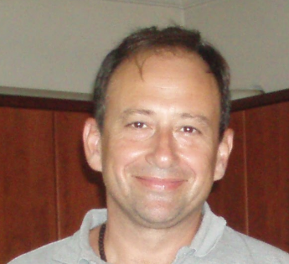
Πεδίο | Συμπληρώστε (στα αγγλικά)
First Last name | Christos Drosos
Affiliation (Professor /Associate Professor) and Department | Laboratory Teaching Personnel of Industrial Design and Production Engineering
Facebook page
Google Scholar page | https://scholar.google.com/citations?user=nDEe-K8AAAAJ&hl=en
Twitter page | https://twitter.com/drososx
Linked in page | https://www.linkedin.com/in/christos-drosos-b1152913/
email | drososx@uniwa.gr
telephone | +306940986503, +302105381347
Office | ZA003, ANCIENT OLIVE GROVE Campus, 250 Thivon & P. Ralli str, Egaleo Postal code 12241, Athens
Web page | http://users.uniwa.gr/drososx/
About me (one short paragraph) | • BSc on Automation and Control System Engineering • MSc on Informatics • Phd on Informatics at University of Piraeus • PostDoc on Informatics at University of Thessaly
Photo

